Slide 1
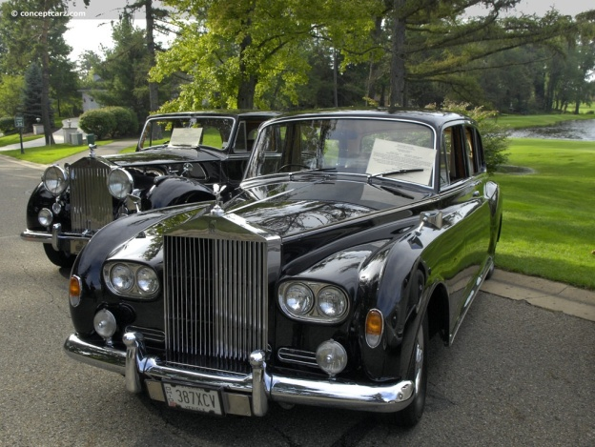
Tapping into the Lucrative Niche of
Luxury Travel
Notes:
Good Evening –and let’s get right into it.
I will say it here and say it again, “Luxury is in the eye of the beholder” and this is one of the important points that will be brought out in this short talk.

Slide 2
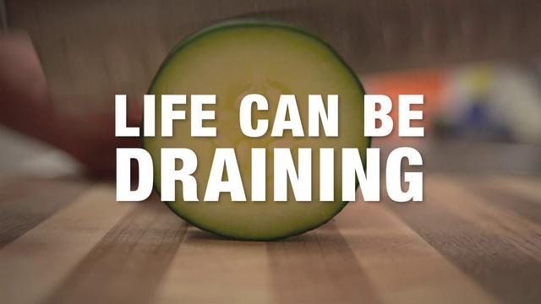
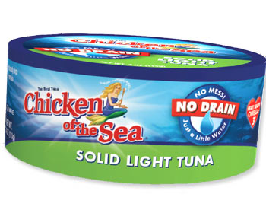
Notes:
I was on the subway earlier this week and I saw this add. A woman next to me, read it out loud and then turned to me and said, “Now that’s luxury”. People are so spoiled these days!
Anecdotally, someone who only stays in Holiday Inn Express and then finally can afford a regular Holiday Inn, may consider this to be ‘luxury’.
But once you know your clients needs inside and out, you can with the appropriate clients, start to be the font of knowledge about more upscale travel options to enhance their experience. On the other end of the scale you can find clients already accustomed to a more upscale travel style and wow them with your knowledge, creativity, positivity and performance.
My talk is geared toward two key concepts 1) Know Thy Client and 2) Know Thy Information and a third key concept that I will introduce later on.
So Let’s get going….
there

Slide 3
Caribbean Week
Toronto
Looking at Luxury Travel
Mass Affluence vs. Luxury
Psychographics—the big Why?
Mind Mapping Luxury
Where do you find Luxury Travellers?
Referrals
The Rules of the Game
Run Around the Caribbean
October 25, 2012
Notes:
Historically, one might point out that the Caribbean has always been associated with luxury and they just need to look at the era of the Pirates in the late 18th and early 19th century to demonstrate this, and the lust for money, gold, jewels and ships. But we also know that this is the Hollywoodized version and except for individuals such as Henry Morgan who actually died a wealthy man, many pirates ended up at the end of a gallow
The islands of the Caribbean have a wealth of their own in terms of enviable sunshine. Gorgeous beaches, warm engaging people, different cultures, traditions, music, sports and the arts. In fact out of the 450 identifiable niche markets in the travel industry, you would be able to find a majority of them represented in this region of the world.
But when it comes down to it, people are drawn to destinations by emotional needs.

Slide 4
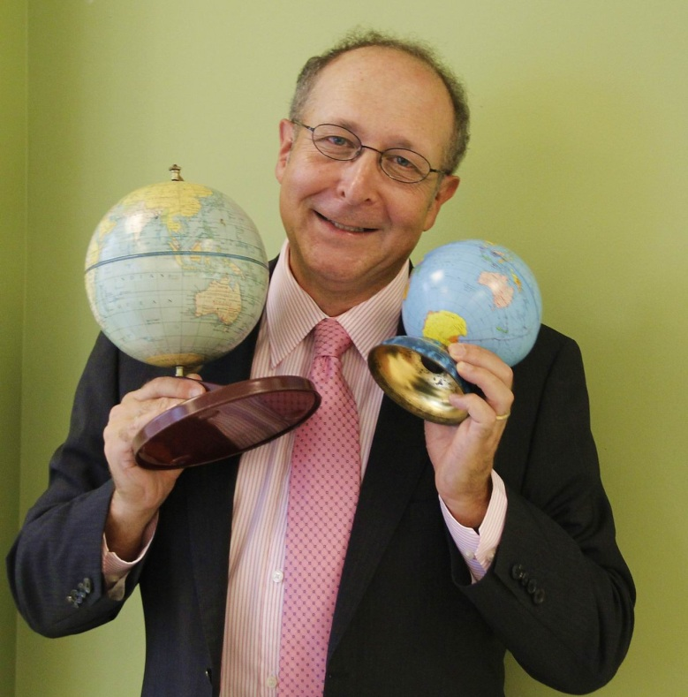
Steve Gillick
President, Talking Travel
Destination Master Class Program
Travelling since the age of 14
Explored 68 countries and
over 500 destinations
30+ years in the travel industry
International speaker & presenter
Travel writer and columnist
Travelindustrytoday.com
Talkingtravelblog.ca
Travelmarketreport.com
Sellingtravel.net
steve@talkingtravel.ca
www.talkingtravel.ca
Notes:
Just before we begin, let me take a minute to satisfy my own emotional needs by telling you who I am.

Slide 5
Terms of Reference
“Luxury”
13th Century ……….
From the Latin luctari: to wrestle or strain
The Act, itself
14th Century:
Sensual Pleasure
Necker Island, BVI
Habit of indulgence in what is choice or costly
17th Century:
Something enjoyable or comfortable beyond life’s necessities
18th Century:
Montpeller Plantation, Nevis
Notes:
And the term luxury itself has changed, somewhat over the years
In the 13th century, based on its roots as wrestling or struggling. The word actually referred to---how do I say this in a mixed crowd..well it referred to The ACT, itself… something that you might do with a preferred personal partner during a romantic evening after the Caribbean sun has set.
Later the word referred to sensual pleasures in general. And this may have referred to anything from food, to music to clothing
In the 17th C it started to take on the meaning that we are more familiar with and by the 18th c it referred to something enjoyable or comfortable beyond life’s necessities.
But you know, in the 21st century, even life’s necessities have been re-defined and therefore what is necessary to you, may not be deemed to be necessary by others. So again, Luxury is a state of mind
And here is where emotion comes into play
Necker Island—RichardBransen
Vieques Island,Puerto Rico
Montpelier Plantation, Nevis
Chateau Lafitte Rothschild 1982—roughly $5000 per bottle

Slide 6
Mass Affluence
VS.
luxury
The democratization of Luxury
Functional
Reward
Indulgence
Notes:
Today, people talk about the democratization of luxury to fill em optional needs. And in marketing lingo, these needs come under the study of emotionomics. What buttons do we push to get you to consider our product.
So to use a non-travel example, if you go into a Mercedes Benz dealership these days, you can buy a B class Sports Tourer listed at $30,000 or you can buy a n SLS AMG Roadster for $220,000. The point is that Mercedes Benz is associated with Luxury cards and even you can afford to walk into the dealership and drive away in a car with that prestigious name on it. This is how Mercedes Benz made luxury affordable and in the travel industry we have hotel chains and cruise lines that have done the same. Some make a distinction between Mass Affluence, in other words, you can stay at the Ritz Carleton or the Four Seasons or Sandals or W , certainly properties that ooze affluence, but pay somewhat less that the top range of pricing, If you checked into the Ritz Carleton . Rosehall, Jamaica today, based on a booking you had made with two weeks notice, you could have a nice garden view room with a balcony for $167.00 per night. Or you could take one of their packages for $700.00 per night.
And this is luxury to many. Others may cringe at staying in a so-called mass affluent property and want something more upscale and private—again we get into travel emotions.
Some luxury travellers are motivated by functionality—in other words, spending for the sake of spending is not practical or realistic. They want superior quality and will conduct extensive pre-purchase research
Others want to reward themselves with a break, relaxation, family time, adventure and something out of their normal routine.
While a 3rd group are in it for pure indulgence.=they like the status symbols and they love acquiring the bragging rights afterward—these are also excellent referral candidates…

Slide 7
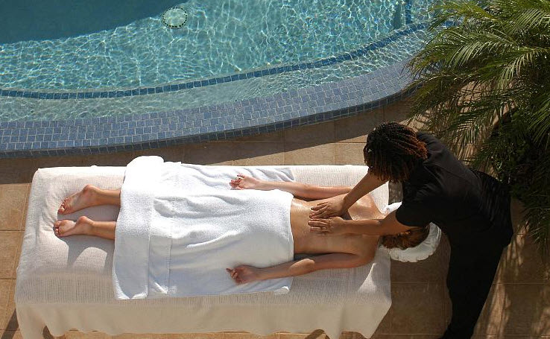
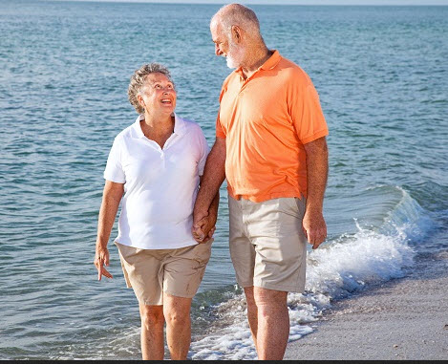
Demographics & Psychographics
Seniors-Mature
Boomers
Gen X
Gen Y
PS
Personal Space
Preferred Status
Spa at Malliouhana, Anguilla
Notes:
Today, luxury seeking customers are younger, more numerous, make their money sooner and are fickle in their choices, Therefore you can’t generalize about their demographic needs, In the past we used to love stereotyping all seniors as liking a certain kind of vacation and the same held true for classifying all boomers or Gen X’ers or Gen y’ers. This is demographics.
Psychographics relates to the individual motivation of travellers—why do they want to travel—what do they want to get out of a travel experience.
Most important point is to build and maintain an in-depth understanding of your clients—and how their needs evolve over time. Their habits, their spending behaviour, their motivations for spending
But also keep in touch with how they feel about the services you provided and how you can change to better address their needs—this is all part of relationship building with the client.
If you really want to generalize about luxury and paint everyone with the same brush, it comes down to personal space—I want things done my way. If I don’t want to see another t living sole for a day or two—then that’s what I want—
And preferred status—I want to feel pampered, as that is lifestyle to which I’m accustomed—or what to be accustomed on this particular holiday.

Slide 8
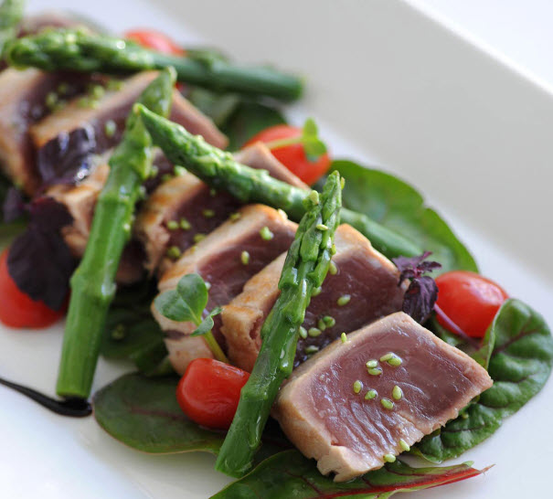
Why Luxury ?
Customized and Tailored
Away from the crowds, hustle, hassle, traffic, sightseers
No line ups or waiting
Unique experiences
Amenities
Culinary
Restaurant at St. Barth’s, Isle de France, St. Barts
Notes:
Luxury Travel Surveys indicate the following answers to”Why Luxury Travel”
Customized and Tailored—which again relates to personal space, personal needs and the over riding requirement for the travel consultant to know their client’s needs
Many luxury travellers, while certainly not anti-social, ant their own head space—they don’t want to crowded beach at Punta Cana during Xmas holiday. A private villa with a private swimming pool and a wall around it is a start
Luxury Travellers are not into waiting—they want the preferred package to allow them to savour their time
They are in to unique experiences—which may relate to specific niches. Eg Silence, or Bungee Jumping or sand surfing or flower arranging—its up to them—but they want it to be pre-arranged.
Amenities—room amenities, at least in the style to which they are accustomed,: soaps, hand cloths, shampoos and body creams, sound system, roses in the bath tub, etc
Culinary Niche—quality of food and drink is extremely important—again, getting back to the emotions of travel. And the corresponding 6 star service is also important.

Slide 9
Enriching Experiences
Above and Beyond
Discerning
Opulent
Choice
Shopping
7 Star
Sports
Romance
Escape
Spas
Ultra…
Family
Nothing
Private
Chefs
New Places
Extraordinary
Privacy
Unique
Helicopter Pads
Private Jets
Seclusion-if you want it
Re-charge your batteries
Experiences
First Class
Notes:
Part of the image of luxury is in understanding all the concepts that your clients think about at the mention of the word ‘luxury”.
And for those clients who need a bit of encouragement—these are words and concepts that you can introduce to them while presenting up-selling options to them to enhance their travel experiences.

Slide 10
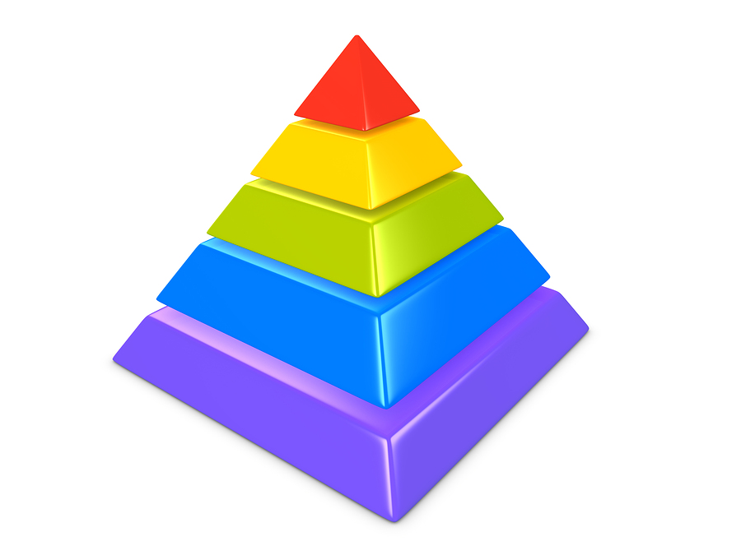
Who Are You?
X pert
X pert
Niche
Niche
Mastery
Mastery
Specialist
Specialist
Generalist
Generalist
Knowledge + Time + Contacts = R.O.I.
Notes:
You need to define what it is you do
You need to adopt your own Mission and Vision Statement—personally—to reflect your accomplishment goals
You need to state in a single sentence what is YOUR value proposition
If you wish to specialize or master in Luxury travel, then your company name, your colour scheme, your website, your demeanor and your attitude must reflect the expectations of your clients. Now this does not mean wandering the streets in your tuxedo, Richard Branson is often photographed in blue jeans—but at least they are very expensive nice looking, clean cut jeans. Again, match your look to the client’s expectations—and if you don’t know what they expect, err on the side of ‘more upscale’
Specialists make the most money in every field—what is your specialist story? Match your experience with your education as well as why you did it.
Narrowly defined specialities help to define you.
Be as specific as possible….the goal is to elicit the response of “ Tell me More”
The other lesson in this cone of achievement is that each new level is based on acquired knowledge. We return to the theme of knowledge is power—know your products inside and out and even moreso, know the people who know the products.

Slide 11
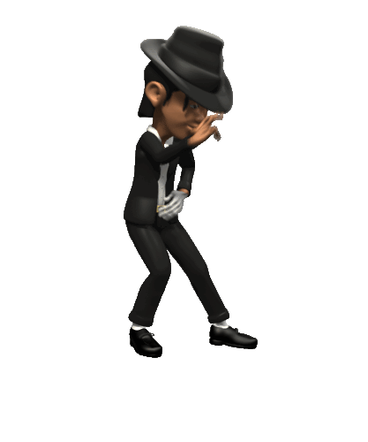
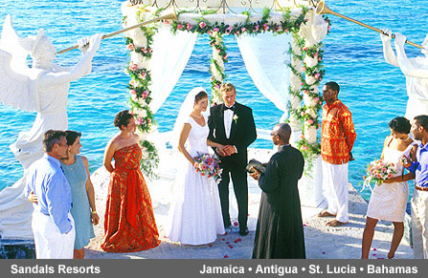
Know the right people
in the Right Places
Personal relationships with on-site contacts
Eg Hotel & Resort General Managers
You want to work with
the Movers and Shakers
Notes:
Contacts and the ability to call upon them to make things happen, especially when you`re dealing with on-location people, can make you look amazing.
You are selling the client YOU—your expertise, your ability to save them time and money through your expertise—and the storehouse of key contacts that you have built up over the years..—key contacts—are something that your clients can`t google. Personal contacts in far-off destinations should be the hallmark of your uniqueness.
Two quick example: On a Fam to St. Lucia one of the agents had an upcoming wedding to arrange. At Ladera and Anse Chatsonnet she spoke with the General Managers and then back in Toronto, after the client had decided on the venue, she used these contacts to ensure that even the smallest of details was personally looked after. These are the types of contacts that clients booking on the internet can’t access. This is where YOU shine.

Slide 12
But hold on for a second…
Where are all these luxury clients coming from?
Notes:
So the big question is, where do these luxury clients come from:
The quick and Easy answer is two places
From your current clients who have needs that you have not uncovered or even have that once-ion-a life-time-trip in mind that they wont be able to afford for another three years
From new clients who you can contact now and build up a working relationship as well as a trust relationship with that may take a few years to come to fruition

Slide 13
Relationship Building
Notes:
And it is no secret that the key to the consultant/client marriage of ideas is in relationship building,
This is going to take some time, You may decide today that you would like to master in luxury but it ain’t going to happen tomorrow. Relationships take time, You need to relate to your clients—and that does not only mean sharing shared interests but also proving that you are a talker and a producer. This is where surveying past clients for their thoughts about your services comes in handy—as well as collecting written and , if appropriate, video testimonials.

Slide 14
A Day in the Life of a Travel Consultant
7:00 am Wake Up
7:45 am Check emails while eating breakfast with spouse and kids
8:15 am Leave for the agency
8:55 am Arrive, Coffee
9:15 am Check email and social media feeds and respond
10:00 am Return phone calls, talk to walk-in clients, research itineraries
11:00 am Meeting with preferred supplier
12:00 am Lunch at your desk and continue with bookings, research and emailing or phoning clients
3:00 pm Webinar on time management
3:30 pm Leave webinar early to talk to clients
4:00 pm Call resorts to check on accessibility for one client
5:00 pm Phone calls, bookings, processing invoices
6:00 pm Depart and head to Product Launch
8:00 pm Arrive home in time to watch Dragon’s Den
9:30 pm Fall asleep during Ice Road Truckers
But…Where’s the Beef ?
Especially if you’re getting into selling Luxury Travel?
Notes:
One more component in developing a luxury clientele includes personal meetings—something that not many travel consultants may have had the time—or the skill to do. But this is one of the keys to relationship building, This is “the beef”

Slide 15
Notes:
Dodging your clients and side stepping them will not work. But come on—you meet people in your office all the time….the next time you may want to offer to meet the client at their office. Remember their time may be at a premium so they are the client—you are the luxury travel provider. Get out of your box and go get the business.

Slide 16
Board of Trade
Yacht Club
CRM
Golf Course
Bank
Clubs
Market
Research
Art Gallery
Sports Events
Agency Name
PRM
Social
Clubs
Social Media
LinkedIn
Referrals
Notes:
And here are some places to get the business. Joining social networks—on the internet or in person are crucial to establishing and then building on relationships. And then , another tactic that some people run away from—is to ask for the business and ask for referrals.
And we are not talking about the Good Old Boys Club Here
In a Strategic Action Resource Report on The Psychology of Luxury Travel, they found in a survey that women are key decision makers when it comes to vacations that tend toward the glamourous classic and elegant. That is their definition of luxury, and this holds true , both in the 18-34 year age group and I the 55 and older age group
Men tend to define luxury holidays as comforting, relaxing and pampering—and the largest contingent is in the 35-54 age group
Agaion, when it comes to defining Luxury as flashy, gaudy or elistist it is the men—mostly in the 18-34 age group which actually fits into the demographic OF Gen Y’s.
Social Media—Linked In—high. Twitter is low but Nolan Burris reminds us that the highest concentration of Facebook users is in the 55+ age group—and that these are women—so this also fits into the demographic of Baby Boomers—who like that glamorous, classic and elegant travel.

Slide 17
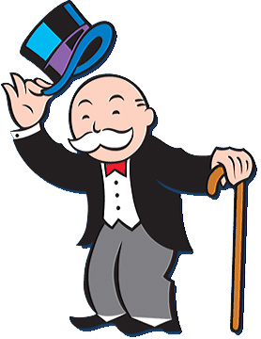
Notes:
If a client is satisfied with the way you’ve responded to their needs, then they will almost always be happy to refer your services. But this means that you have to double down on your homework and really know your stuff. This is where you use your personal contacts and learn the brochures and the internet sites—and then learn to verify information so that you can attest to the fact that it is up to date.

Slide 18
Notes:
And here are some more tips from Luxury travel experts as you eye the greener glass through the keyhole. Keys to success include…

Slide 19
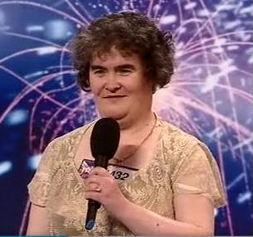
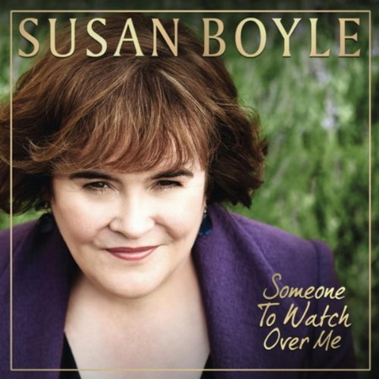
Don’t Judge a Book…
2009
2012
Notes:
Steve Crowhurst tells the story of when he was working at Thomas Cook 30 some years ago and a woman in an old shift and no makeup into the agency cartrying a brown paper bag. No one bothered to ask to help—in fact no one wanted to waste their time speaking with her at all. Finally some one did and out of the bag came $25,000 in cash for the life-time dream cruise she had been saving for.
Don’t Pre-Judge

Slide 20
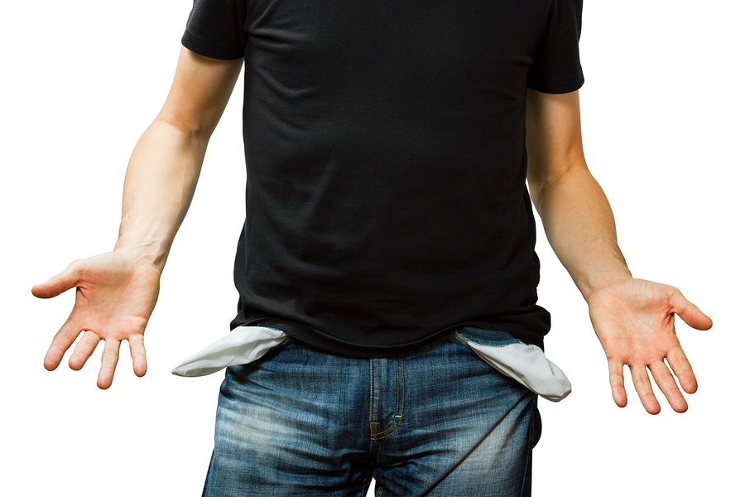
Don’t think out
of your own pockets
Notes:
Never commiserate with clients over high prices. Never be in a position to say that “Yes I know the cruise is $200,000—that’s a lot of dough to be spending” WRONG
Never think with your own pocketbook. You can`t be timid of act shocked at the price of high-end hotels , suites on cruise ships or special arrangements.
The sooner you are comfortable with high prices the sooner you will be able to close sales
Relate this back to the first time you had to ask for a service fee from a client. You may have been a bit intimidated but now you realize that if you don’t get that fee, you don’t pay the mortgage. It’s the same thing. A price is a reflection of the type of service to expect and the quality of that service.

Slide 21
Price is only an issue…
in the absence of value
Notes:
The absolutely most important thought I can import to you today is that Price is only an issue in the absence of value. When you are dealing with luxury hotels, cruises, services, arrangements, the price reflects the effort product. You are not in the $125.00 for a twin including a coffee maker scenario. You are into the concierge or private butler service and the meal where YOU tell the Chef what you would like to eat and he/she cooks it to your specifications.

Slide 22
Don`t Bluff…
Know and Speak
the experience.
Notes:
Don`t make up experiences `motherhoody` pictures of the resort or hotel or cruise ship that your client is asking about
Know the unique nuances between business class and first class. Know the hottest, latest, hippest, trendiest and who’s got the best chef-restaurants
Know and speak the experiences
If you don`t know—then research it and get back. That`s an excellent question that I am not 100% sure of the answer to so let me contact the resort and I will get back to you, pronto.
Know the comparison analytics! Do the comparison shopping for your clients—i.e. know all the options out there
Go to industry events. Even if you`re not going to stay at THE Parrot Key in Turks and Caicos, you can meet the general manager and start to build a relationship

Slide 23
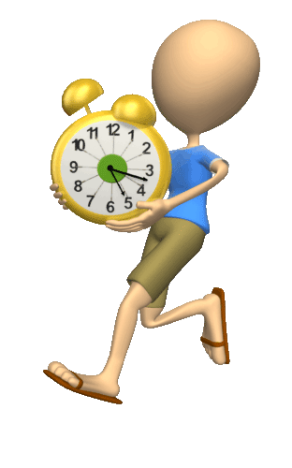
Take your time!
Don’t underestimate the skills investment
Notes:
The biggest mistake people make in seeking to be the best is that they expect it to occur overnight—and that ain’t going to happen.
While the beauty and awe of luxury may be mesmerizing, newcomers to the field are often too impatient to succeed –they don’t appreciate that acquiring skills and relationships is a time investment. Luxury expertise should be a long term goal and in the mean time, build up your knowledge base, refine your CRM practices to ask more in-depth questions and talk to luxury travellers—interview them, if you will, to find out how they book travel, where they get the information, how they like to communicate. What kind of referrals do they trust in choosing a travel consultant and a destination can Out-Behave the competition and deliver extraordinary services?
What’s the competition doing. Can you brainstorm to see how your services
Peer Group referrals are important (and you thought Trip Advisor was King of the referral engines.

Slide 24
Where else?
Luxury Institute —have complimentary white papers and annual surveys and trends in the Luxury Market
Virtuoso and check out www.youtube.com/user/VirtuosoTraveler
Industry News...Industry Events
Updates from Tourist Boards and Resorts and ...Tourist Boards!
Magazines: Condé Nast (and website),
The Affluent Traveller,
Islands,
‘Great,Grand and Famous Hotels’
Social networks
Luxury channel TV plus
Notes:
Social networks 7 out of 10 wealthy consumers belong to at least one social network

Slide 25
Media‘Great Hotels of the World’ www.ghotw.com
www.adventurecollection.com
www.sparklingvoyages.com
www.luxuryta.com
www.justluxe.com
www.forbes.com
www.LuxuryTravelAdvisor.com
www.luxurytravelexpo.com (Nov 27-29/12);
websites of hotels and resorts and cruise ships;
www.luxurytravrlu.com
www.Travelagentacademy.com
And Tourist Boards

Slide 26
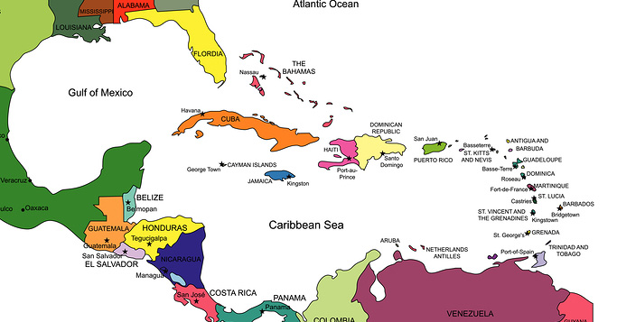
A quick Luxury Run Around some of the Caribbean nations
KNOW YOUR CLIENT
KNOW YOUR INFORMATION
KNOW YOUR’S AND YOUR PRODUCTS’ USP
UNIQUE SELLING POINTS

Slide 27
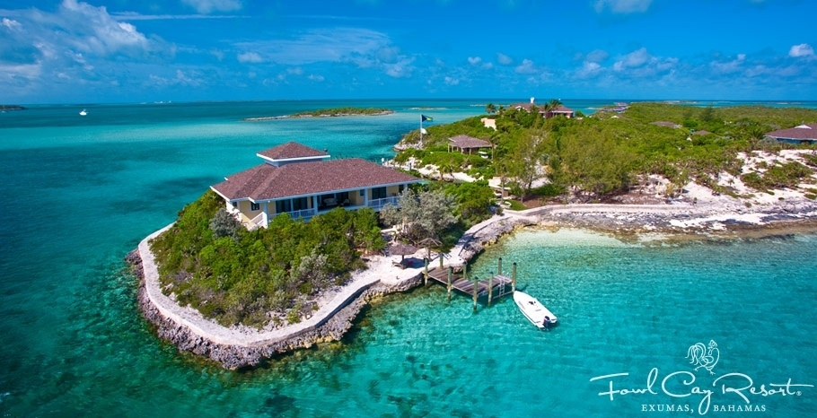
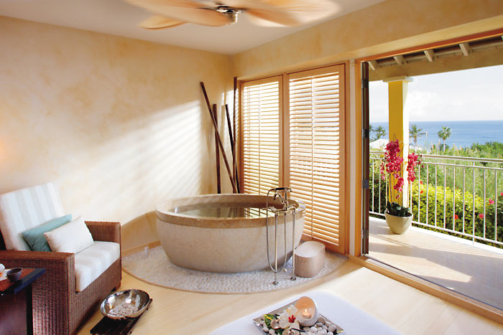
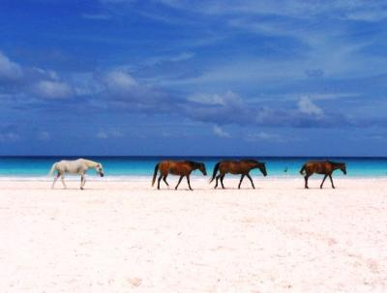
The Bahamas
Bermuda
Fowl Cay Resort
Pink Sands, Harbour Island
Spa Suite, Mandarin Oriental Elbow Beach
Carlisle Bay
Rosewood Tuckers’ Point
Pink Beach Club and Cottages
The Reefs
Newstead Belmont Hills
Fairmont Southampton
Pompano Beach Club
The Cove, Atlantis
Sandals, Emerald Bay, Great Exuma
Sandals, Royal Bahamian
Notes:
CuisinArt Golf Resort and Spa is an award-winning oasis of luxury nestled in the gentle curve of Anguillas Rendezvous Bay, where shimmering blue waters and powdery white sand serve as the perfect backdrop. Lush gardens wind their way past the infinity pool to the stunning beachfront suites, each with spectacular views of the Caribbean Sea, while the Villas By CuisinArt afford the intimacy of an Island home, with private pools and full resort services. The renowned Venus Spa offers 16 treatment rooms, incl couples and VIP suites, a healing waters pool, a tranquil relaxation room, a complimentary Fitness Center, and an internationally trained staff. Guests will feast on exquisite cuisine featuring the resorts freshly picked produce, harvested from the on-site hydroponic and organic farms, and cooking classes are available. Culinary options incl the elegant Le Bistro at Santorini, its Chefs Table, poolside Cafe Mediterraneo, the Beach Grill, Italia at the Club House and Tokyo Bay, Anguillas first authentic Japanese restaurant, featuring inspired cuisine in a seductive setting. The Wine Cellar offers award-winning intl selections with tastings available. The 18 Hole Greg Norman Signature Design Championship Course offers stimulating play with superb elevation changes, spectacular water features, and challenging holes. Players are greeted by a spectacular view of St. Maarten and the Caribbean Sea at the tee box of the 384-yard starting hole. The Course is 7,063 yards, Par 72, with a course rating of 75.6 and a slope rating of 134. Discover why Robb Report calls the 1st hole The Caribbeans answer to the 18th at Pebble Beach. The Clubhouse offers Lunch and Dinner daily at Italia, and the Golf Shop Leading Hotels of the World—3 Diamond Award from AAAThe dining experience at Malliouhana is enhanced by its vast wine list, featuring wines from many parts of the world.
With over 1,300 wines listed in the menu and around 25,000 bottle of wine in its cellar, since 1998 Michel Rostang at Malliouhana restaurant has been honoured to receive the Wine Spectator Grand Award – one of only two Caribbean properties – for showing passion and commitment when it comes to wine.

Slide 28
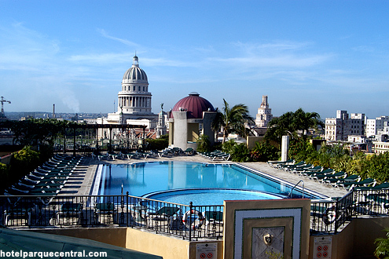
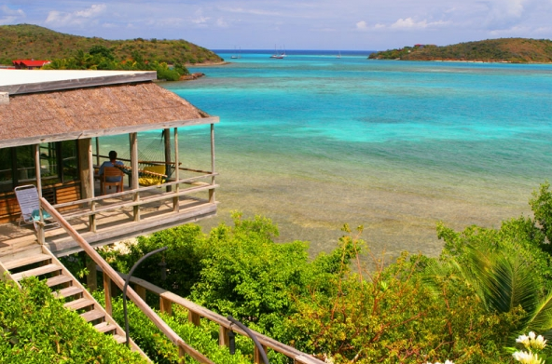
British Virgin Islands
CUBA
Bitter End Yacht Club,Island of Virgin Gorda
Hotel Parque Centrale, Havana
Carlisle Bay
Hotel Saratoga, Havana
Hotel SantaIsabel, Havana
Resort Barcelo Cay Libertad
Blau Veradero
Paradisus Veradero
Iberostar Gran Hotel, Trinidad
Scrub Island Resort, Spa and Marina, off Tortola
Rosewood, Little Dix Bay
Little Dix Bay Villas
Necker Island, (Richard Branson)
Aquamare, Virgin Gorda
Peter Island Resort and Spa
Biras Creek Resort, V.G.
Notes:
CuisinArt Golf Resort and Spa is an award-winning oasis of luxury nestled in the gentle curve of Anguillas Rendezvous Bay, where shimmering blue waters and powdery white sand serve as the perfect backdrop. Lush gardens wind their way past the infinity pool to the stunning beachfront suites, each with spectacular views of the Caribbean Sea, while the Villas By CuisinArt afford the intimacy of an Island home, with private pools and full resort services. The renowned Venus Spa offers 16 treatment rooms, incl couples and VIP suites, a healing waters pool, a tranquil relaxation room, a complimentary Fitness Center, and an internationally trained staff. Guests will feast on exquisite cuisine featuring the resorts freshly picked produce, harvested from the on-site hydroponic and organic farms, and cooking classes are available. Culinary options incl the elegant Le Bistro at Santorini, its Chefs Table, poolside Cafe Mediterraneo, the Beach Grill, Italia at the Club House and Tokyo Bay, Anguillas first authentic Japanese restaurant, featuring inspired cuisine in a seductive setting. The Wine Cellar offers award-winning intl selections with tastings available. The 18 Hole Greg Norman Signature Design Championship Course offers stimulating play with superb elevation changes, spectacular water features, and challenging holes. Players are greeted by a spectacular view of St. Maarten and the Caribbean Sea at the tee box of the 384-yard starting hole. The Course is 7,063 yards, Par 72, with a course rating of 75.6 and a slope rating of 134. Discover why Robb Report calls the 1st hole The Caribbeans answer to the 18th at Pebble Beach. The Clubhouse offers Lunch and Dinner daily at Italia, and the Golf Shop Leading Hotels of the World—3 Diamond Award from AAAThe dining experience at Malliouhana is enhanced by its vast wine list, featuring wines from many parts of the world.
With over 1,300 wines listed in the menu and around 25,000 bottle of wine in its cellar, since 1998 Michel Rostang at Malliouhana restaurant has been honoured to receive the Wine Spectator Grand Award – one of only two Caribbean properties – for showing passion and commitment when it comes to wine.

Slide 29
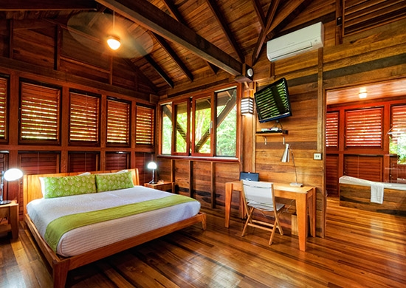
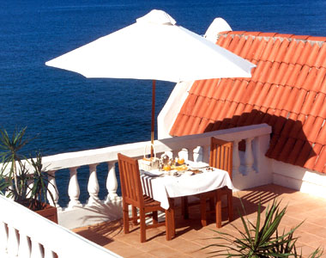
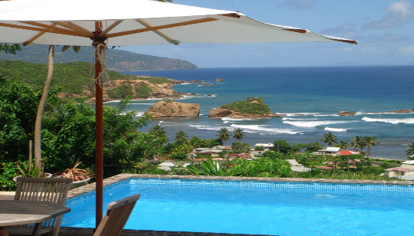
Dominica
Puerto Rico
Secret Bay
The Horned Dorset Primavera, Rincon
Carlisle Bay
W on Vieques Island
St. Regis Bahia Beach
Las Castitas Village (Waldorf Astoria)
Ritz Carlton
El Conquistador (Golden Door Spa)
Aria Sea Luxury Villas
Petit Coulibri Guest Cottages
Exotica
Fort Young Hotel
Red Rock Haven
Notes:
CuisinArt Golf Resort and Spa is an award-winning oasis of luxury nestled in the gentle curve of Anguillas Rendezvous Bay, where shimmering blue waters and powdery white sand serve as the perfect backdrop. Lush gardens wind their way past the infinity pool to the stunning beachfront suites, each with spectacular views of the Caribbean Sea, while the Villas By CuisinArt afford the intimacy of an Island home, with private pools and full resort services. The renowned Venus Spa offers 16 treatment rooms, incl couples and VIP suites, a healing waters pool, a tranquil relaxation room, a complimentary Fitness Center, and an internationally trained staff. Guests will feast on exquisite cuisine featuring the resorts freshly picked produce, harvested from the on-site hydroponic and organic farms, and cooking classes are available. Culinary options incl the elegant Le Bistro at Santorini, its Chefs Table, poolside Cafe Mediterraneo, the Beach Grill, Italia at the Club House and Tokyo Bay, Anguillas first authentic Japanese restaurant, featuring inspired cuisine in a seductive setting. The Wine Cellar offers award-winning intl selections with tastings available. The 18 Hole Greg Norman Signature Design Championship Course offers stimulating play with superb elevation changes, spectacular water features, and challenging holes. Players are greeted by a spectacular view of St. Maarten and the Caribbean Sea at the tee box of the 384-yard starting hole. The Course is 7,063 yards, Par 72, with a course rating of 75.6 and a slope rating of 134. Discover why Robb Report calls the 1st hole The Caribbeans answer to the 18th at Pebble Beach. The Clubhouse offers Lunch and Dinner daily at Italia, and the Golf Shop Leading Hotels of the World—3 Diamond Award from AAAThe dining experience at Malliouhana is enhanced by its vast wine list, featuring wines from many parts of the world.
With over 1,300 wines listed in the menu and around 25,000 bottle of wine in its cellar, since 1998 Michel Rostang at Malliouhana restaurant has been honoured to receive the Wine Spectator Grand Award – one of only two Caribbean properties – for showing passion and commitment when it comes to wine.

Slide 30
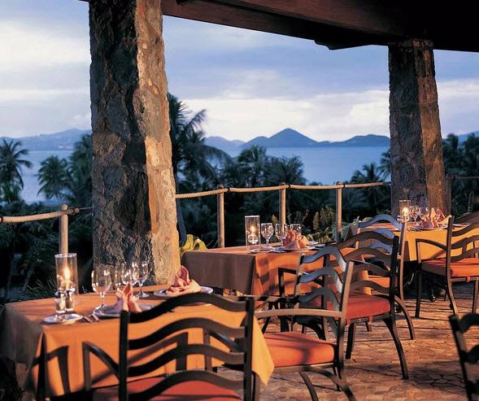
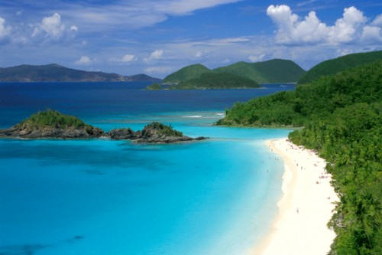
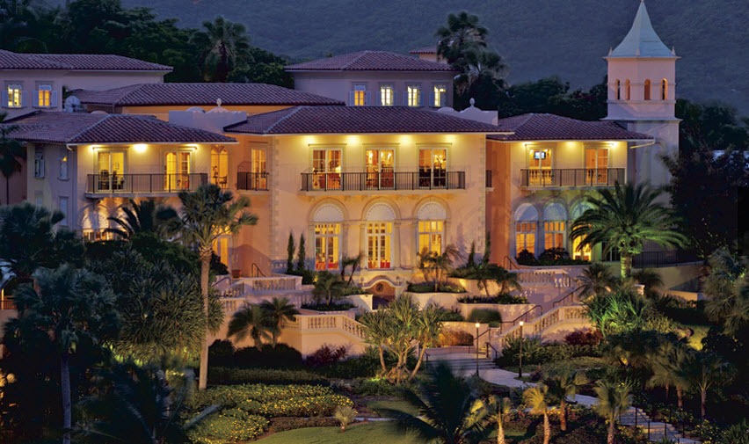
US Virgin Islands
And more…
Amongst the 30
Island Nations
Aruba
Belize
Bonaire
Montserrat
St. Eustatius
St. Maartin
Trinidad & Tobago
Guyana
Haiti
AND>>>
Caneel Bay, St. John
The Westin St.John Resort and Villas
Carlisle Bay
Ritz Carlton St Thomas
Notes:
CuisinArt Golf Resort and Spa is an award-winning oasis of luxury nestled in the gentle curve of Anguillas Rendezvous Bay, where shimmering blue waters and powdery white sand serve as the perfect backdrop. Lush gardens wind their way past the infinity pool to the stunning beachfront suites, each with spectacular views of the Caribbean Sea, while the Villas By CuisinArt afford the intimacy of an Island home, with private pools and full resort services. The renowned Venus Spa offers 16 treatment rooms, incl couples and VIP suites, a healing waters pool, a tranquil relaxation room, a complimentary Fitness Center, and an internationally trained staff. Guests will feast on exquisite cuisine featuring the resorts freshly picked produce, harvested from the on-site hydroponic and organic farms, and cooking classes are available. Culinary options incl the elegant Le Bistro at Santorini, its Chefs Table, poolside Cafe Mediterraneo, the Beach Grill, Italia at the Club House and Tokyo Bay, Anguillas first authentic Japanese restaurant, featuring inspired cuisine in a seductive setting. The Wine Cellar offers award-winning intl selections with tastings available. The 18 Hole Greg Norman Signature Design Championship Course offers stimulating play with superb elevation changes, spectacular water features, and challenging holes. Players are greeted by a spectacular view of St. Maarten and the Caribbean Sea at the tee box of the 384-yard starting hole. The Course is 7,063 yards, Par 72, with a course rating of 75.6 and a slope rating of 134. Discover why Robb Report calls the 1st hole The Caribbeans answer to the 18th at Pebble Beach. The Clubhouse offers Lunch and Dinner daily at Italia, and the Golf Shop Leading Hotels of the World—3 Diamond Award from AAAThe dining experience at Malliouhana is enhanced by its vast wine list, featuring wines from many parts of the world.
With over 1,300 wines listed in the menu and around 25,000 bottle of wine in its cellar, since 1998 Michel Rostang at Malliouhana restaurant has been honoured to receive the Wine Spectator Grand Award – one of only two Caribbean properties – for showing passion and commitment when it comes to wine.

Slide 31
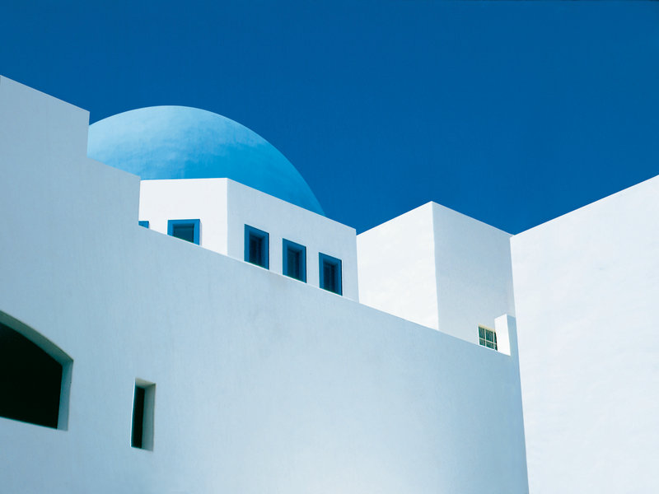
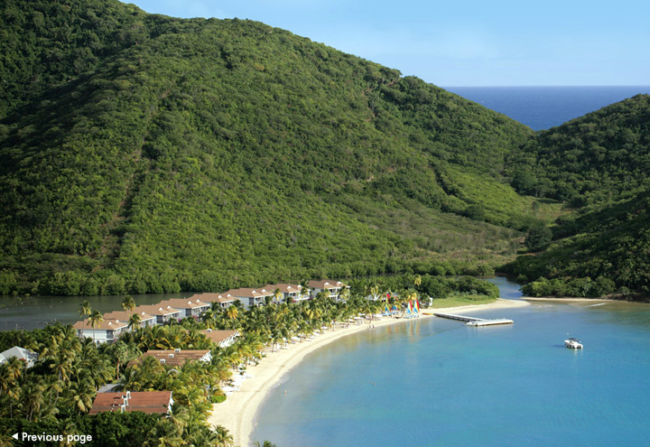
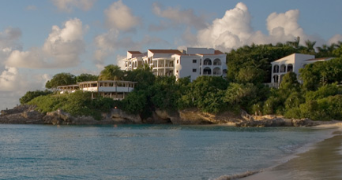
Anguilla
Antigua
& Barbuda
CuisinArt Golf Resort & Spa
Cap Juluca
Carlisle Bay
Hermitage Bay
Inn at English Harbour
St. James Club
Curtain Bluff
Malliouhana Hotel & Spa
Notes:
CuisinArt Golf Resort and Spa is an award-winning oasis of luxury nestled in the gentle curve of Anguillas Rendezvous Bay, where shimmering blue waters and powdery white sand serve as the perfect backdrop. Lush gardens wind their way past the infinity pool to the stunning beachfront suites, each with spectacular views of the Caribbean Sea, while the Villas By CuisinArt afford the intimacy of an Island home, with private pools and full resort services. The renowned Venus Spa offers 16 treatment rooms, incl couples and VIP suites, a healing waters pool, a tranquil relaxation room, a complimentary Fitness Center, and an internationally trained staff. Guests will feast on exquisite cuisine featuring the resorts freshly picked produce, harvested from the on-site hydroponic and organic farms, and cooking classes are available. Culinary options incl the elegant Le Bistro at Santorini, its Chefs Table, poolside Cafe Mediterraneo, the Beach Grill, Italia at the Club House and Tokyo Bay, Anguillas first authentic Japanese restaurant, featuring inspired cuisine in a seductive setting. The Wine Cellar offers award-winning intl selections with tastings available. The 18 Hole Greg Norman Signature Design Championship Course offers stimulating play with superb elevation changes, spectacular water features, and challenging holes. Players are greeted by a spectacular view of St. Maarten and the Caribbean Sea at the tee box of the 384-yard starting hole. The Course is 7,063 yards, Par 72, with a course rating of 75.6 and a slope rating of 134. Discover why Robb Report calls the 1st hole The Caribbeans answer to the 18th at Pebble Beach. The Clubhouse offers Lunch and Dinner daily at Italia, and the Golf Shop Leading Hotels of the World—3 Diamond Award from AAAThe dining experience at Malliouhana is enhanced by its vast wine list, featuring wines from many parts of the world.
With over 1,300 wines listed in the menu and around 25,000 bottle of wine in its cellar, since 1998 Michel Rostang at Malliouhana restaurant has been honoured to receive the Wine Spectator Grand Award – one of only two Caribbean properties – for showing passion and commitment when it comes to wine.

Slide 32
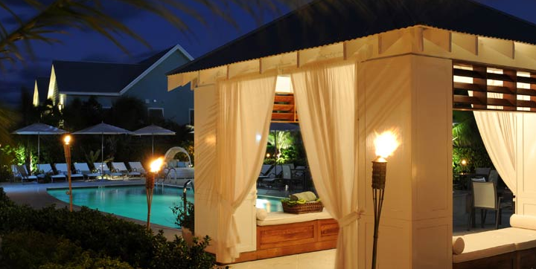
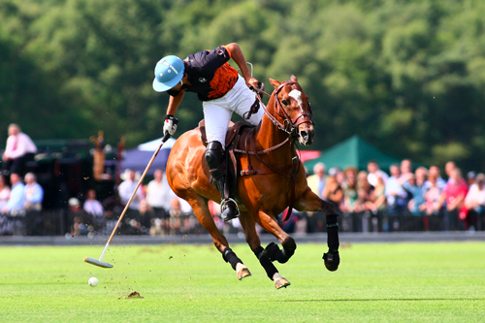
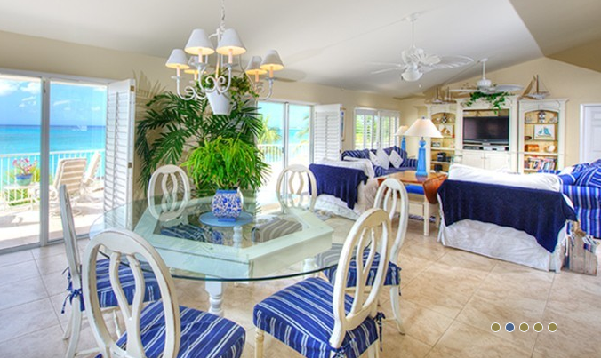
Cayman Islands
Barbados
Sandy Lane
Private Villas, West Coast
The Cotton Tree, Grand Cayman,
Apes Hill Polo Club, Barbados
Ritz Carleton, Grand Cayman
The Westin Casuarina Resort and Spa
Villas of Distinction/ Caymanvillas.com
Greg Norman
Notes:
CuisinArt Golf Resort and Spa is an award-winning oasis of luxury nestled in the gentle curve of Anguillas Rendezvous Bay, where shimmering blue waters and powdery white sand serve as the perfect backdrop. Lush gardens wind their way past the infinity pool to the stunning beachfront suites, each with spectacular views of the Caribbean Sea, while the Villas By CuisinArt afford the intimacy of an Island home, with private pools and full resort services. The renowned Venus Spa offers 16 treatment rooms, incl couples and VIP suites, a healing waters pool, a tranquil relaxation room, a complimentary Fitness Center, and an internationally trained staff. Guests will feast on exquisite cuisine featuring the resorts freshly picked produce, harvested from the on-site hydroponic and organic farms, and cooking classes are available. Culinary options incl the elegant Le Bistro at Santorini, its Chefs Table, poolside Cafe Mediterraneo, the Beach Grill, Italia at the Club House and Tokyo Bay, Anguillas first authentic Japanese restaurant, featuring inspired cuisine in a seductive setting. The Wine Cellar offers award-winning intl selections with tastings available. The 18 Hole Greg Norman Signature Design Championship Course offers stimulating play with superb elevation changes, spectacular water features, and challenging holes. Players are greeted by a spectacular view of St. Maarten and the Caribbean Sea at the tee box of the 384-yard starting hole. The Course is 7,063 yards, Par 72, with a course rating of 75.6 and a slope rating of 134. Discover why Robb Report calls the 1st hole The Caribbeans answer to the 18th at Pebble Beach. The Clubhouse offers Lunch and Dinner daily at Italia, and the Golf Shop Leading Hotels of the World—3 Diamond Award from AAA

Slide 33
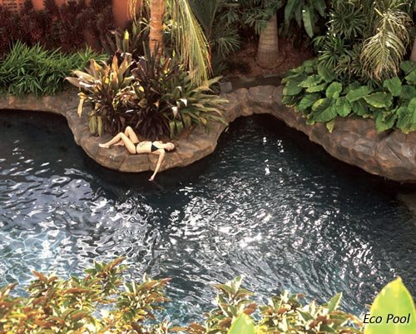
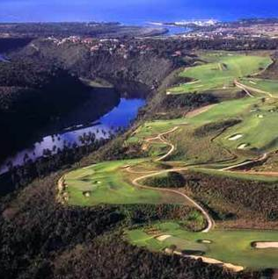
Curacao
Dominican Republic
Kura Hulanda (The Bachelorette)
Teeth of the Dog Golf Course
La Romana
Hyatt Regency Golf Resort Spa & Marina
Baoase Luxury Resort
Casa de campo (golf)
Casa Kimball, Punta Cana
Iberostar Hacienda Dominicus

Slide 34
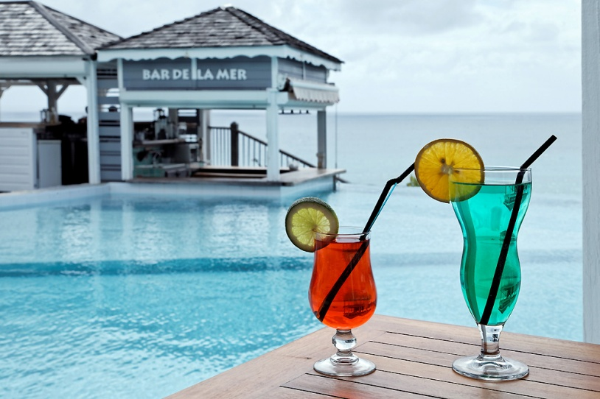
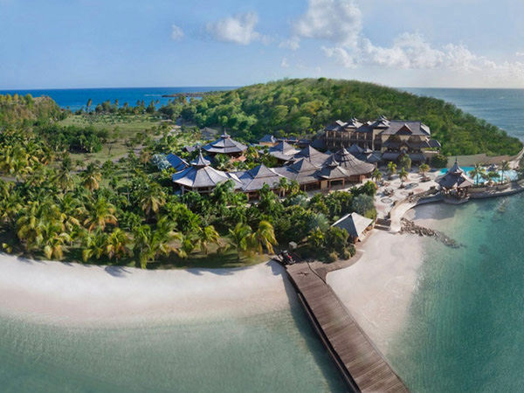
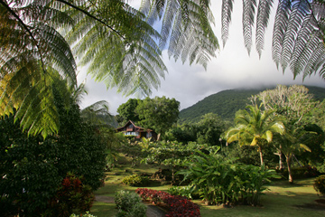
Grenada
Guadeloupe
La Toubana Hotel and Spa
Spice Island Beach Resort
Laluna
Bel Air Plantation
Orchard Bay Villa
The Beach House at Mount Hartman Bay Estate
Le Jardin Melanga Hotel
Auberge de la Vieille Tour
Habitation Tendacayou
Hotel St. Georges
L'auberge Les Petits Saintes Aux Anacardies
Le Hamak

Slide 35
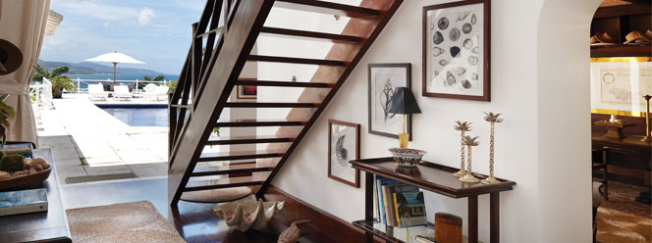
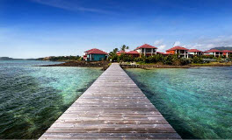
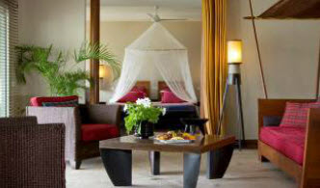
Jamaica
Martinique
Round Hill Resort and Hotel, Montego Bay
Golden Eye -Oracabessa Bay
Jamaica Inn –Ocho Rios
Ritz Carlton at Rosehall
Sandals Montego Bay
Sandals Negril
Sandals Royal Caribbean, M/B
Sandals Whitehouse
Sandals Royal Plantation O.R
Moon Dance Villas. Negril
Couples, Swept Away
Cap Est Lagoon Resort and Spa

Slide 36
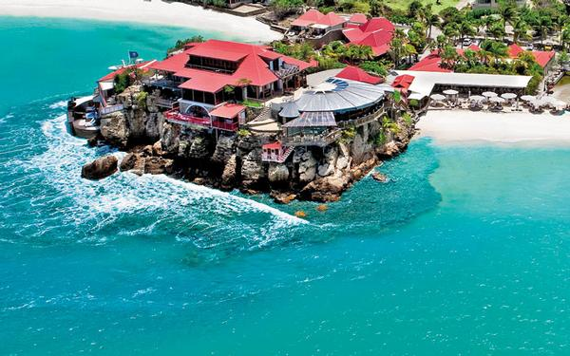
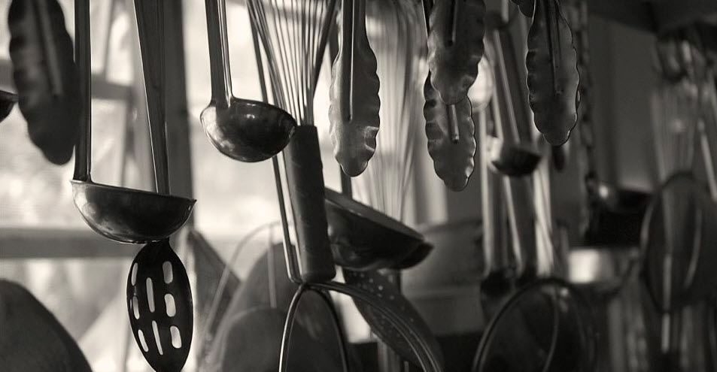
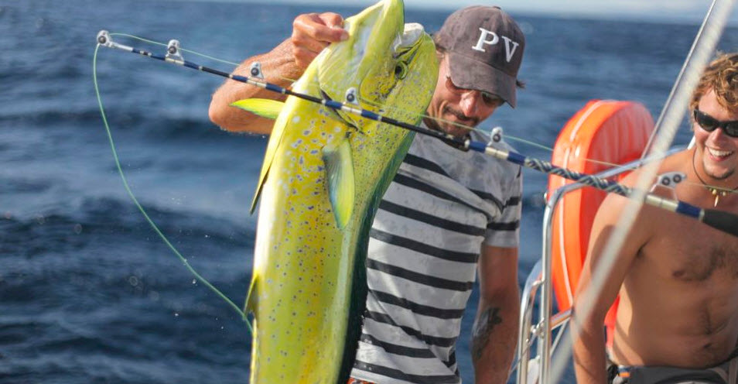
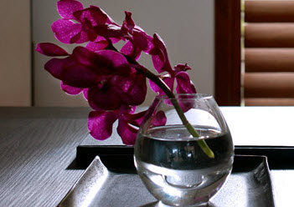
St. Barts
St. Kitts & Nevis
Montpelier Plantation and Beach-Nevis
(Princess Di and other Royalty)
Eden Rock- Rockstar room with Recording Studio, Nina room with Art Gallery
Hotel St Barth Isle of France
Le Sereno
La Plage
Nisbet Plantation Beach Club
Four Seasons

Slide 37
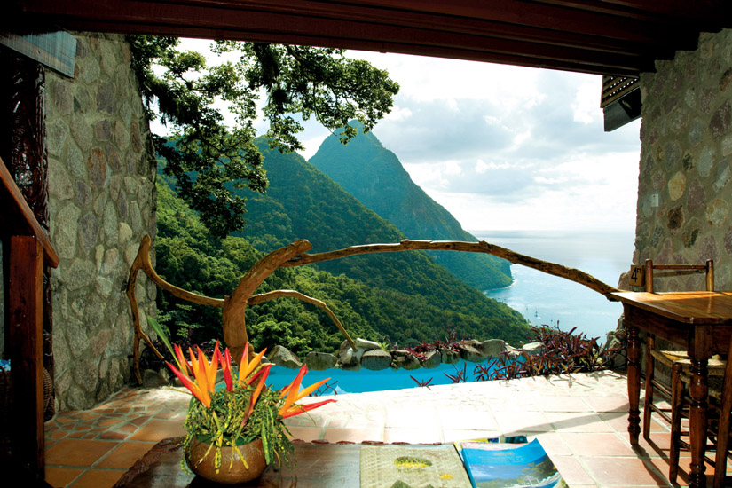
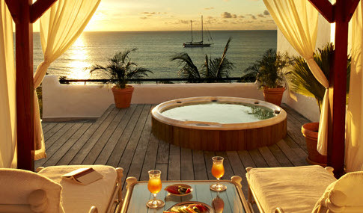
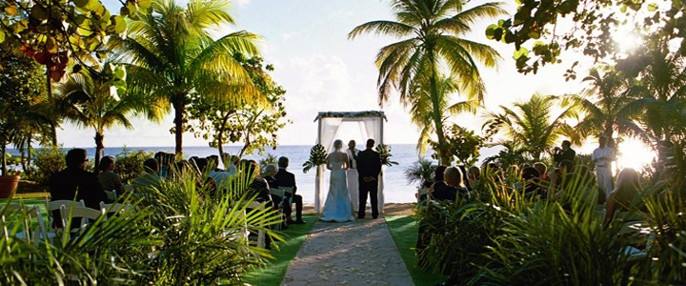
St. Lucia
St. Martin
Ladera Resort
La Semanna Luxury Resort & Spa
Anse Chastanet
Sandals Regency Golf Resort and Spa
The Landings Hotel
Sandals St. Lucian
Jade Mountain
Cap Maison
The Body Holiday, Le Sport (“IT Spa of the Caribbean”, Francis Ford Coppola at Virtuoso Conference in August)

Slide 38
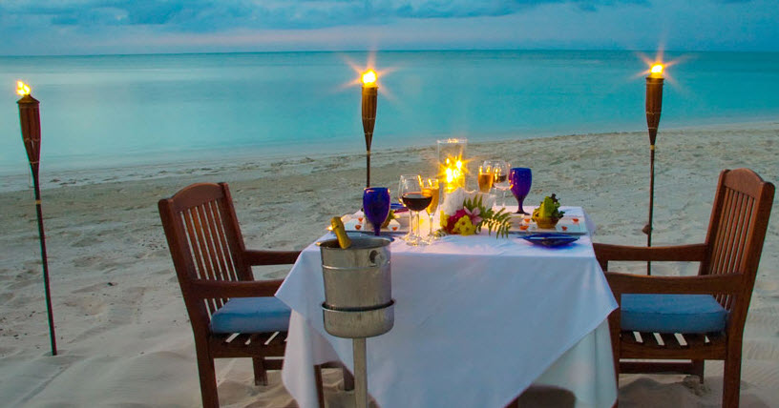
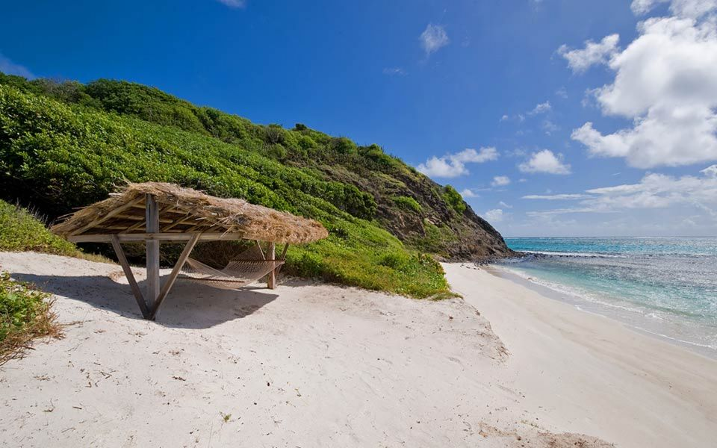
St. Vincent &
the Grenadines
Turks and Caicos
Petite St.Vincent Private Island
Grace Bay Club
Mustique...Mick Jagger/David Bowie
Palm Island
Cotton House, Mustique
Regent Palms
Parrot Cay-Shambhala Retreat Spa

Slide 39
Luxury is a state of mind…
Be mind-ful
of the opportunities
In the Caribbean

Slide 40
Thank you!
Steve@talkingtravel.ca

